Slide 1
Break Day

Slide 2
To-do list
Questions on HW
Questions on extra credit HW
Final exam format discussion
Interviewing discussion
Logic problems

Slide 3
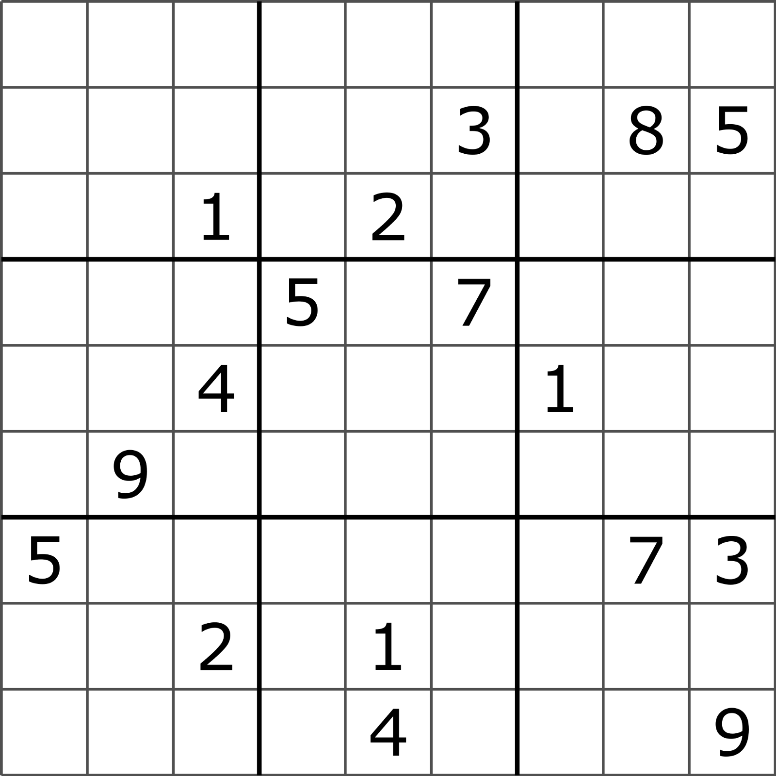
HW questions

Slide 4

Extra credit HW questions

Slide 5
Final exam format discussion
Limiting time feels unfair to me.
Many of you are strong programmers, you just go at a slower pace.
Keep in mind, this is something employers consider.
Two options
Lots of code/classes but easy project
Little code/classes but complex project

Slide 6
Interviewing discussion
Interviewer cares more about your process than the solution.
Analyze and decompose the problem. Explain your thought process.
Know what questions to ask.
Be prepared for “soft skills” questions. - These suck!
First interview is usually to test your actual skills. A degree is important, but the range of skill levels between graduates is vast.
Second interview is to ensure you are someone they want to work with. Likely no technical questions here.

Slide 7
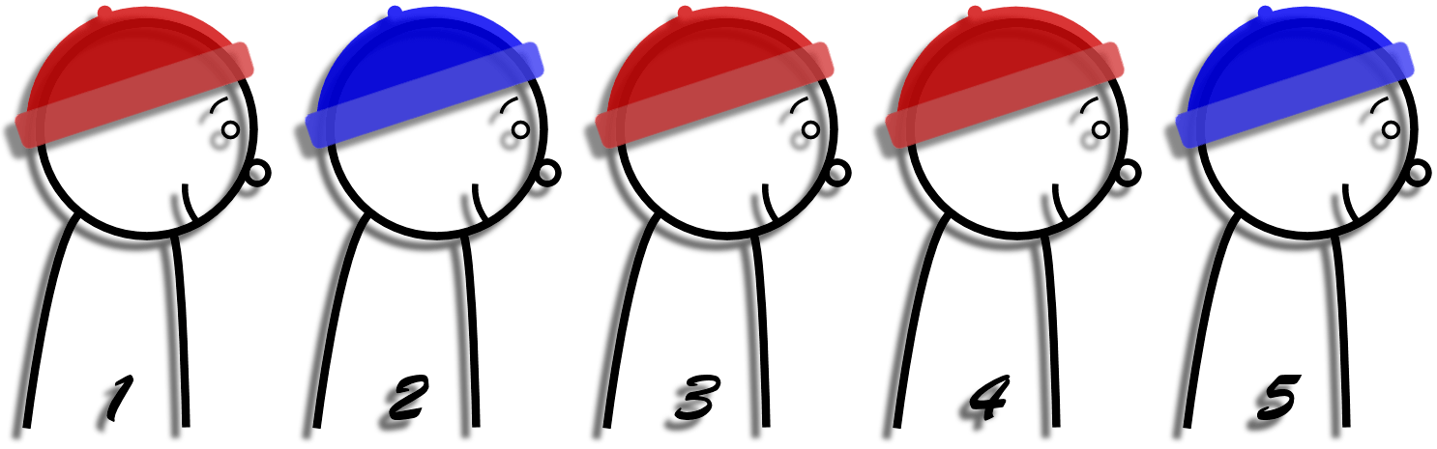
Logic Problems
An executioner lines up 100 prisoners single file and puts a red or a blue hat on each prisoner's head. Every prisoner can see the hats of the people in front of him in the line - but not his own hat, nor those of anyone behind him. The executioner starts at the end (back) and asks the last prisoner the color of his hat. He must answer "red" or "blue." If he answers correctly, he is allowed to live. If he gives the wrong answer, he is killed instantly and silently. (While everyone hears the answer, no one knows whether an answer was right.) On the night before the line-up, the prisoners confer on strategy to help them. What should they do?
http://puzzles.nigelcoldwell.co.uk/thirtynine.htm

Slide 8

Logic Problems
A princess visits an island inhabited by two tribes. Members of one tribe always tell the truth, and members of the other tribe always lie.
The princess comes to a fork in the road. She needs to know which road leads to the castle to avoid the fire-breathing dragon and rescue the prince from the wizard holding him captive in the castle. (Although the princess doesn't know it, the south road leads to the castle and the north road leads to the dragon.)
Standing at this fork in the road is a member of each tribe, but the princess can't tell which tribe each belongs to. What question should she ask to find the road to the castle?
http://mathforum.org/dr.math/faq/faq.liar.html

Slide 9

Logic Problems
One morning, at 7:00, a Buddhist monk began hiking up a narrow trail that leads to the top of a tall mountain. The monk ascended the trail at varying rates of speed and stopped several times along the way to eat and rest. The monk reached the top at 7:00 that evening. After a night of meditation, the monk started going down the trail at 7:00 in the morning. Again, the monk walked at various rates of speed and stopped several times along the route. The monk reached the bottom of the trail at 7:00 in the evening.
Will there always be some spot along the path that the monk passed at precisely the same time on both days?
https://mathlair.allfunandgames.ca/wanderingmonk.php

Slide 10
Logic Problems
Brian tells you that he knows of at least five different ways to multiply a number by 3 via programming. He tells you the obvious first three methods:
Multiplication: n * 3
Addition: n + n + n
For loop: for(i := 0, 2) { sum += n }
Without directly mimicking these obvious three, what are the two other methods for multiplying a number by 3?
1: https://tinyurl.com/y3khoslx 2: https://tinyurl.com/yyrpgrnq

